Slide 1
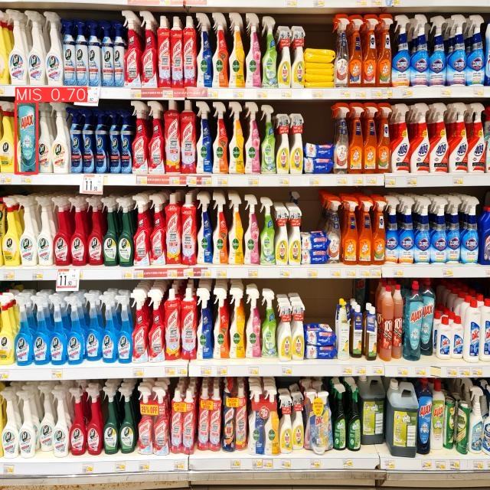

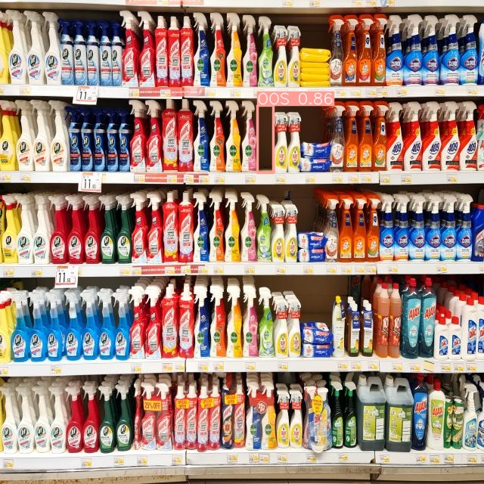
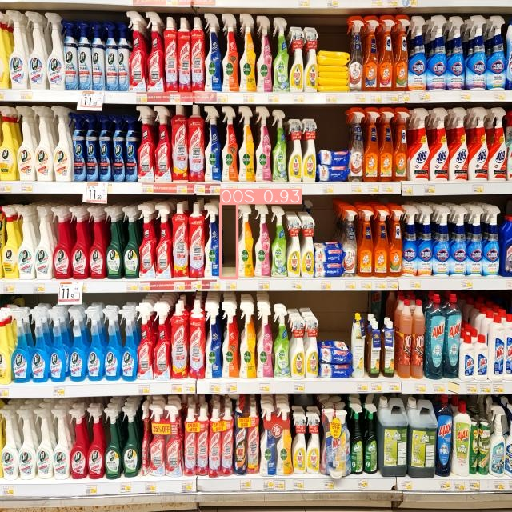
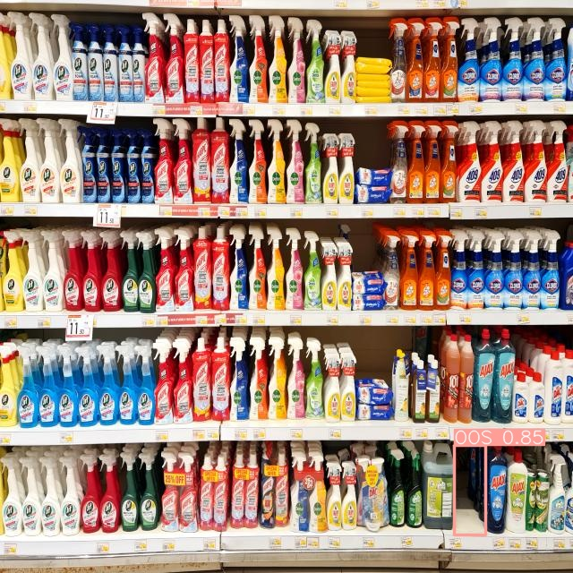
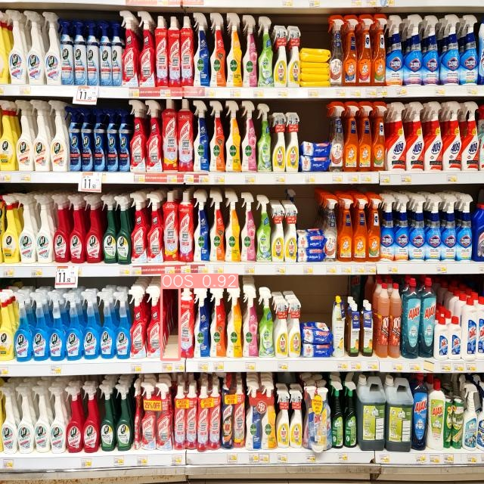
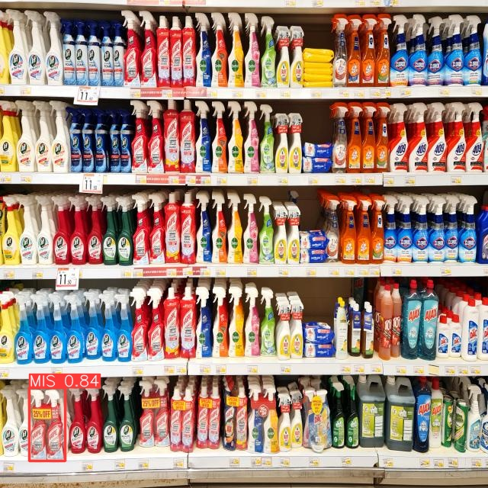
231-ICS-619 Project Video-based Retail Store Shelf Monitoring
Khaled Almutairy
Mamoun Alghaslan
Notes:
Hello
Welcome to the video based retail store shelf monitoring
My name is Mamoun Alghaslan, and I am delighted to show you our Shelf Monitoring System, which I worked on with my team mate Khaled Almutairy
This project is prepared as part of the requirements for the ICS-619 for the professional master in artificial intelligence from KFUPM with the mentorship of Dr. Elsayed Elalfy and Dr. AbdulJabbar Siddiqi.

Slide 2
Introduction
Recent trends in retail focus on AI-Powered shops, such as Amazon Go, Grabango, and Walmart’s Intelligent Retail Lab
Our proposed projects aims to build a robust Shelf-Monitoring-System (SMS) to tackle Out-of-Stock (OOS) and Misplaced (MIS) items
Key components include a sliding camera system mounted on the opposing sides of shelves, connected to a web server that hosts a detection model, and a notification system that can provide real-time updates
Notes:
There has been recent trends in retail that focused on AI-Powered shopping experience, such as Amazon Go, Grabango, and Walmart’s Intelligent Retail Lab
Our proposed projects aims to build a robust Shelf-Monitoring-System (SMS) to tackle Out-of-Stock (OOS) and Misplaced (MIS) items.
The system has a few key components, starting with a sliding camera system that would be mounted on the opposing sides of shelves, connected to a web server that hosts a detection model, and a notification system that can provide real-time updates
Before going into more details, let’s quickly go over some existing solutions

Slide 3
Existing Solutions
Deep Learning methods
Other methods
Faster R-CNN
A two-stage architecture, first generating region proposals and then predicting class labels, and bounding box coordinates
Generally slower due to its two-stage process
YOLO
A single-stage architecture, simultaneously predicting class probabilities and bounding box coordinates in one pass through the network.
Known for its real-time object detection capabilities, achieving faster inference speeds.
Classical Methods
Do not generalize well when applied to new environments.
Depth Estimation Method
Fail to detect product misplacement
Notes:
Other than the multi-sensor solutions, there have been some deep learning methods such as “faster R-CNN”,
Which is a two-stage architecture, first generating region proposals and then predicting class labels, and bounding box coordinates.
It is Generally slower due to its two-stage process
Another approach which we developed on is the You Only Look Once framework, YOLO, which is:
A single-stage architecture, simultaneously predicting class probabilities and bounding box coordinates in one pass through the network.
It is known for its real-time object detection capabilities, achieving faster inference speeds.
Other methods such as the classical methods of statistical analysis and basic machine learning do not generalize well when applied to new environments.
Depth estimation methods are successful but fail to detect product misplacement since it lacks the visual classification of object.

Slide 4


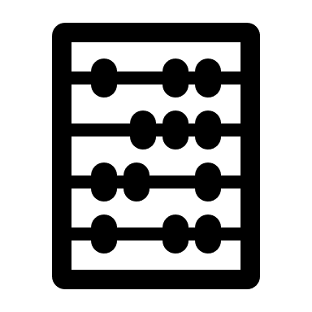









Our solution
Notes:
Let’s talk more about our solution.
The basic idea is as follows:
Cameras are installed on
sliding rails in front of
the shelves.
The cameras are connected using wifi
To a web server, which hosts
The object detection model.
The application can be used by admins to
manage the database,
As well as the broadcasting service that will
Notify the on-floor employees

Slide 5
Prototype
Collected & labelled images from Danube supermarket
Experimented with YOLO v5 and v7, & Fine-tuned v8 on the dataset
Built a simple web interface to the object detection model
Notes:
To build our prototype, we:
Collected & labelled images from Danube supermarket
Experimented with YOLO v5 and v7, & Fine-tuned v8 on the dataset
Built a simple web interface to the object detection model
For Data collection,

Slide 6
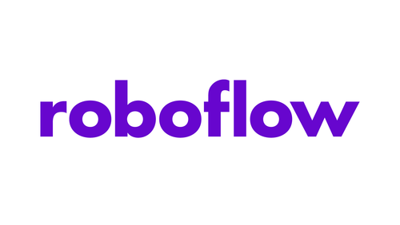
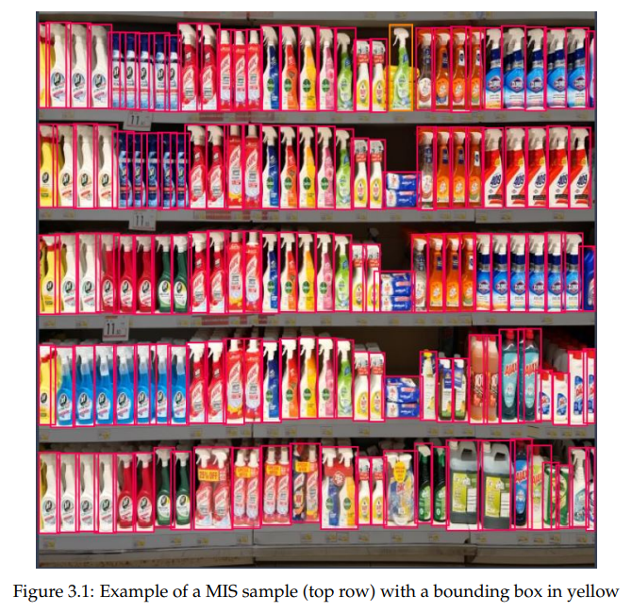
Data Collection
Danube Supermarket
Focused on five shelves ~150 products
Each product was removed to simulate OOS, and 32 product were moved around five times to simulate MIS
A total of 310 images were collected and augmented
Data set was split 90/5/5% with balanced samples of classes
Notes:
We visited the Danube supermarket in AlKhobar, and using a mobile phone fixed on a tripod, we sampled five shelves which had a total of about 150 products.
Each product was removed to simulate OOS situations, and 32 product were moved around five times to simulate product misplacement
A total of 310 images were collected and labelled using Roboflow
Data set was split 90/5/5% with balanced samples of classes

Slide 7
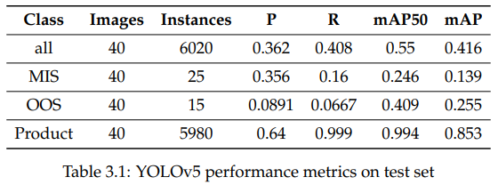
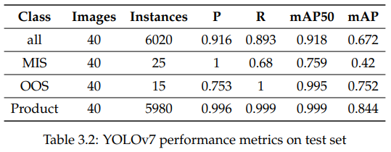
Experiments
YOLOv5
YOLOv7
Paperspace Jupyter Notebook, Quadro-P6000 GPU, 5- and 2.5-hours training time respectively
Notes:
To run a few experiments and understand the framework we will use in the system, we experimented with yolo versions 5 and 7.
Yolov5 did not perform well, and took more than 5 hours to train on a quadro-P6000 GPU. V7 had impressive results, but had a weakness distinguishing misplaced items.
Please feel free to pause the video and look at the numbers in details,

Slide 8
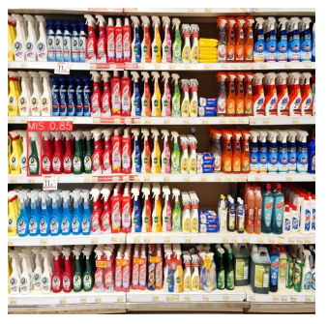
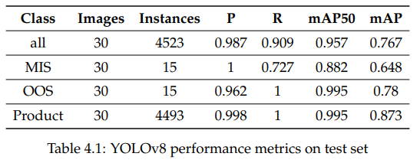
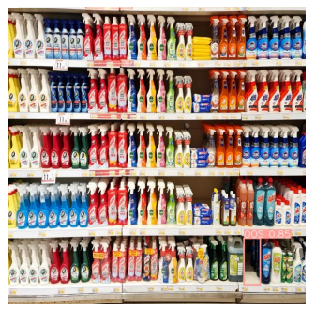
Model fine-tuning
YOLOv8s
Results
Notes:
YoloV8, the model we selected for the system, showed remarkable results. It almost completely correctly detected OOS products, and a solid mAP50 score of 0.88 for misplaced products.
The photo shows a sample with on misplaced item in the middle row to the left, and an OOS product in the bottom row to the right.
After exporting the model weights,

Slide 9
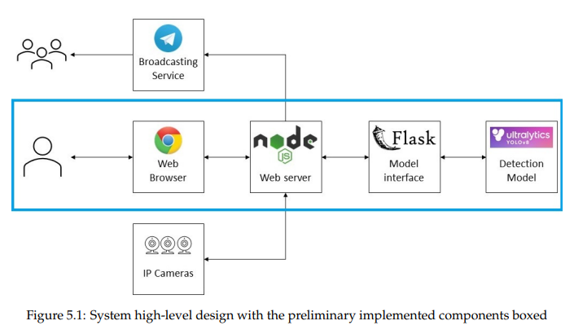
System Design
Components
Diagram
Detection model
Model API [Python + Flask]
IP Cameras
Web Server [Node.js + Express]
Web-site server
Web worker
Broadcasting service
Notes:
We started with the system components.
The system comprises of for main parts:
The detection model we fine-tuned
The Model API, which is a Python + Flask application
IP Cameras which will monitor the shelves
A Web Server built using JavaScript Node.js + Express, the web server has three parts:
A Web-site server which allows the admins to manage IP camera registry, and the employees that will be notified using the broadcasting service
A Web worker which will periodically take images from all configured cameras for analysis
Broadcasting service
For this prototype, only the middle layer highlighted in blue was implemented.

Slide 10
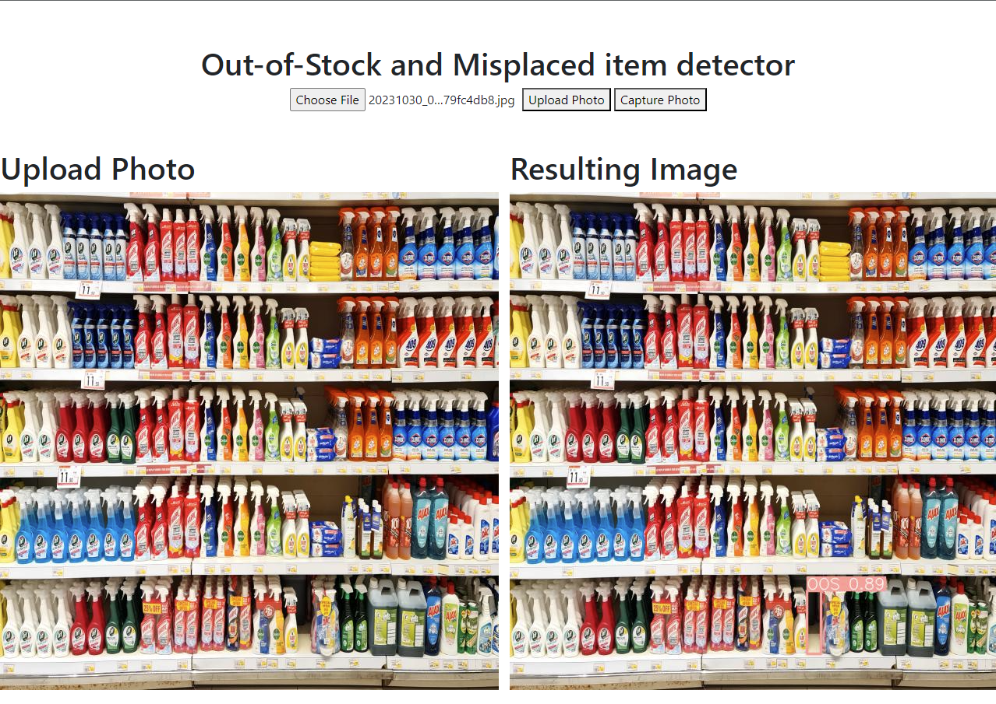
Prototype
Notes:
Here’s a screen shot of the prototype.
The user is able to upload a photo and send it to the server, or capture a photo using a camera.
In colcusion,

Slide 11
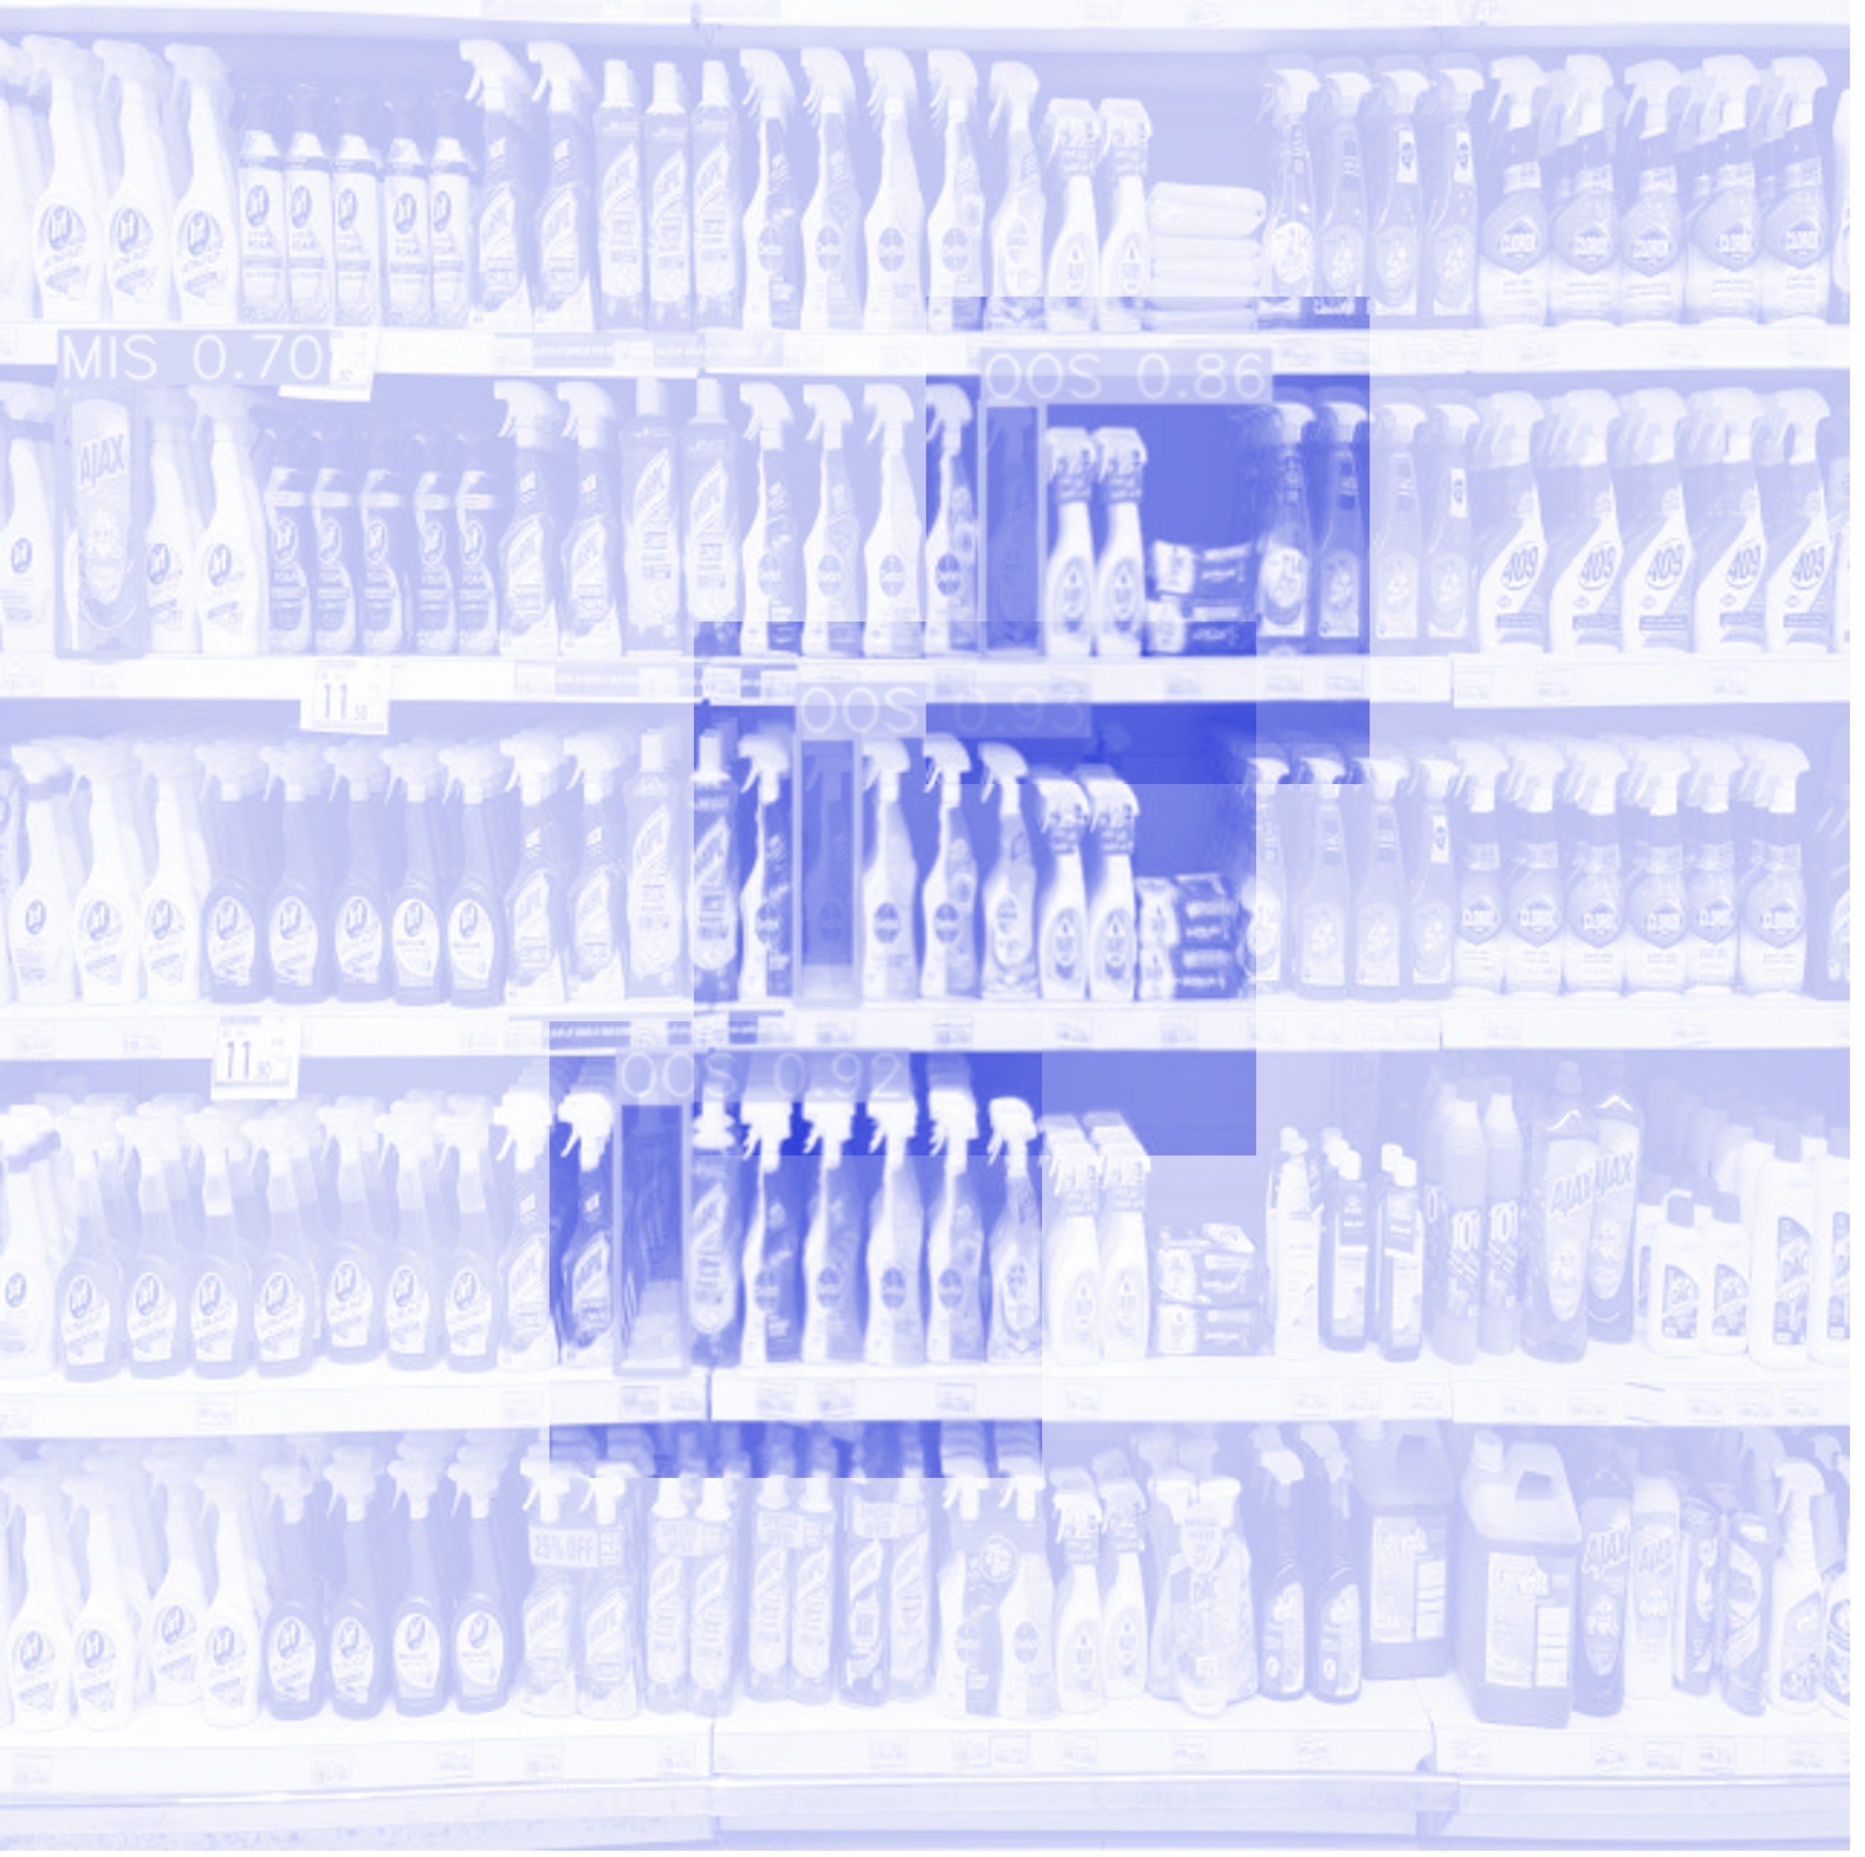
Conclusion
Collected and labelled a new dataset from Danube supermarket for Out-Of-Stock (OOS) and product misplacement (MIS).
Fine-tuned an existing model and achieved mean Average Precision (mAP) of 0.882 for MIS and 0.995 for OOS.
Developed a preliminary prototype of the Video-based Retail Store Shelf Monitoring System (SMS) using deep learning as a proof-of-concept.
Notes:
We Collected and labelled a new dataset from Danube supermarket for Out-Of-Stock (OOS) and product misplacement (MIS).
Fine-tuned an existing model and achieved mean Average Precision (mAP) of 0.882 for MIS and 0.995 for OOS.
Developed a preliminary prototype of the Video-based Retail Store Shelf Monitoring System (SMS) using deep learning as a proof-of-concept.
For future work,

Slide 12
Future work
Real-world testing in a supermarket
Refining accuracy by expanding the dataset
Scaling the system to include multiple IP-cameras
Exploring broadcasting services
Notes:
We will focus on Real-world testing in a supermarket
And continue refining accuracy by expanding the dataset
Also Scaling the system to include multiple IP-cameras
And Exploring multiple broadcasting services

Slide 13
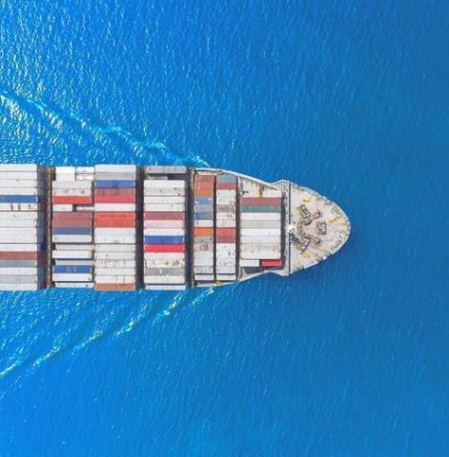
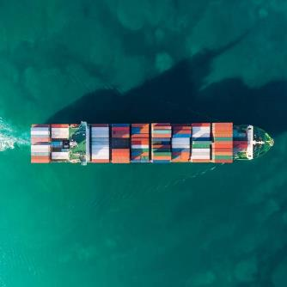
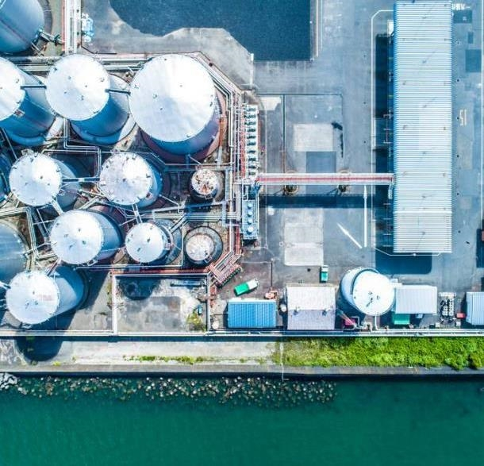
THANK YOU
Mamoun Alghaslan, Khaled Almutairy
Notes:
Thank you very much for your time
We hope this project will become marketable and useful in the near future.
Have a great day.

